Slide 1
Growing Incredible Managers:
Business Models to Drive Innovation
Prepared by
Greg Mathers, Certified Adizes Senior Associate
June-July 2019
Projekts Nr./ CFLA līgums Nr. 1.2.2.3/16/i/001

Slide 2


Appex Case Discussion
What are the PIPs facing Ghosh when takes over?
Agree on and be ready to discuss 3 key lessons from the case with Appex Corp.
Is there anything you think Ghosh should have done differently and if so, what is it?
©Adizes Institute 2019

Slide 3
The Business Model Canvas
Key Partners
Who are our key partners?
Who are our key suppliers?
Which key resources are we acquiring from our partners?
Which key activities do partners perform?
Key Activities
What key activities do our value propositions require?
Our distribution channels?
Customer relationships?
Revenue streams?
Value Proposition
What value do we deliver to the customer?
Which one of our customers’ problems are we helping to solve?
What bundles of products and services are we offering to each segment?
Which customer needs are we satisfying?
What is the minimum viable product?
Customer Relationships
How do we get, keep and grow customers?
Which customer relationships have we established?
How are they integrated with the rest of our business model?
How costly are they?
Customers
How do we get, keep and grow customers?
Which customer relationships have we established?
How are they integrated with the rest of our business model?
How costly are they?
Text Goes Here
Text Goes Here
Text Goes Here
Text Goes Here
Text Goes Here
Key Resources
What key resources do our value propositions require?
Our distribution channels?
Customer relationships?
Revenue streams
Channels
Through which channels do our customer segments want to be reached?
Text Goes Here
Text Goes Here
Cost Structure
What are the most important costs inherent to our business model?
Which key resources are most expensive?
Which key activities are most expensive?
Revenue Streams
For what value are our customers really willing to pay?
For what do they currently pay?
What is the revenue model?
What are the pricing tactics?
Text Goes Here
Text Goes Here

Slide 4
Lean Canvas
Project Name
01-Jan-2014
Iteration #x
Problem
Top 3 problems
Solution
Top 3 features
Unique Value Proposition
Single, clear, compelling message that states why you are different and worth paying attention
Unfair Advantage
Can’t be easily copied or bought
Customer Segments
Target customers
Key Metrics
Key activities you measure
Channels
Path to customers
Cost Structure
Customer Acquisition costs
Distribution costs
Hosting
People, etc.
Revenue Streams
Revenue Model
Life Time Value
Revenue
Gross Margin
PRODUCT
MARKET

Slide 5
Element | Business Model Canvas | Lean Canvas
Target | New and existing businesses | Startup businesses purely
Focus | Customers, Investors, Entrepreneurs, Consultants, Advisors | Entrepreneurs purely
Customers | Lays emphasis on customer segments, channels and customer relationships for all businesses | Does not lay much emphasis on customer segments because startups have no known or tested products to sell
Approach | It lays down the infrastructure, lists the nature and sources of financing and the anticipated revenue streams of the business | It begins with the problem, a proposed solution, the channels to achieving the solution, costs involved and the anticipated revenue streams
Competition | It focuses on value proposition in quantitative and qualitative terms as way to stay smart in the market | It assesses whether the business has an unfair advantage over the rest and how to capitalize on it for better grounding
Application | It fosters candid understanding, creativity, discussion and constructive analysis | It is a simple problem-solution oriented approach which enables the entrepreneur to develop step-by-step

Slide 6
Source of corporate success

Slide 7
Organizational Lifecycles &
Related Business Models
It is not the strongest of the species that survive, nor the most intelligent, but the one most responsive to change.
Charles Darwin
Growing
Aging

Slide 8
Flexibility
Controllability
Predictability
Growing
Aging

Slide 9
Flexibility
Controllability
Death
Growing
Prime
Aging

Slide 10
The “organization” is an ‘idea’
Building Commitment
Founder(s) run the risk of losing control
Prophet or Profit?
Commitment < Risk → Affair
Courtship
Affair

Slide 11
The company is born when risk is taken
“We don’t need any more ideas, WE NEED RESULTS.”
Action oriented
Few policies, systems, procedures, budgets
Job description: everything
Limited delegation
Authoritarian Leadership
Infancy
Courtship
Affair

Slide 12
Loss of commitment
Vulnerability, a problem can become a crisis on short notice
Loss of cash
Loss of window of opportunity (timing)
Loss of founder
Loss of family support
Loss of “life”
Infancy
Infant Mortality
Courtship
Affair

Slide 13
Organization is Arrogant
Rapid Growth
Sales Oriented
Organized around people, not around tasks
Lack of Accountability
Opportunity driven
Too many priorities
Assumes →More revenue = More profits
Go-go
Infancy
Infant Mortality
Courtship
Affair

Slide 14
Crisis prompts the transition to the next stage on the lifecycle
Getting sued
Lose their shirts
Bad investments
Go-go
Infancy
Courtship

Slide 15
Needs:
Transition
Priorities
Systems & Accounting/Accountability
Order
Professional Management
SECOND BIRTH
Love Hate Relationship
Go-go

Slide 16
Needs:
Transition
From: Entrepreneurial Management
To: Professional Management
Go-go

Slide 17
Divorce
The Risk averse squeezes out the entrepreneurial partners or management
Premature Aging
Divorce
Adolescence
Unfulfilled Entrepreneur
Go-go
Founders Trap
The Revolving Door Entrepreneur / Founder unwilling or unable to make the necessary adolescence adaptations fires the professional managers and administrators….AGAIN
Infant Mortality
Infancy
Courtship
Affair

Slide 18
Needs:
Transition
From: More is Better
To: Better is More
New Definition of the Company
Change of Organization Structure
Change of Incentive Systems
Change Accountability and Information System
Leadership Transition
Go-go

Slide 19
“Us” versus “Them” mentality
Internal conflicts
Inconsistency in goals and in compensation systems
Temporary loss of Vision
Policies made but not adhered to
Major Transitions: Delegation of Authority, Change in Leadership, and Goals Displacement
Entrepreneurship feels threatened by Administration
Yo-Yo: “You’re in charge. No, I’m in charge”
Adolescence
Go-go
Infant Mortality
Infancy
Courtship
Affair

Slide 20
If an effective transition to Adolescence is not made…
the organization falls into Founder’s/Family Trap
Go-go
Founders Trap
Organization ages and dies when the Founder ages
Infant Mortality
Infancy
Courtship
Affair

Slide 21
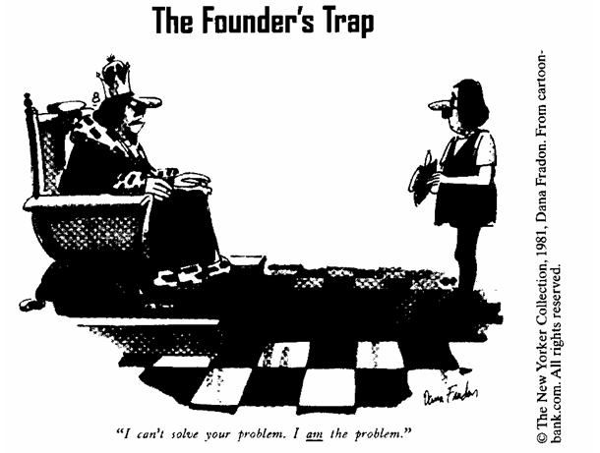

Slide 22
The “Optimum” Region
Prime
Divorce
Unfulfilled Entrepreneur
Balanced self-control, & flexibility
Functional organization structure
Insufficient managerial depth
Can increase sales AND profits simultaneously
Creates new infant organizations
Reorganizes and Emancipates as needed
Adolescence
Premature Aging
Go-go
Founders Trap
Infant Mortality
Infancy
Courtship
Affair

Slide 23
Stable
1
2

Slide 24
Growing Companies
Aging Companies
Personal success stems from taking risk
Expectations exceed results
The organization is in cash poor
The organization emphasizes function over form
People focus on why and what to do
People are kept for their contributions despite their personalities
Everything is permitted, unless expressly forbidden
Problems are seen as opportunities
The marketing and sales departments have political power
People on the line call the shots
Responsibility is not matched with authority
Management drives the organization
Management drives the momentum
Change in leadership can lead to change in organizational behavior
The organization needs consultants
The organization exists to create value
Personal success stems from avoiding risk
Results exceed expectations
The organization is in cash rich
The organization emphasizes form over function
People focus on how and who did it
People are kept for their personalities despite their lack of contributions
Everything is forbidden, unless expressly permitted
Opportunities are seen as problems
The accounting, finance and legal departments have political power
Corporate staff calls the shots
Authority is not matched with responsibility
The organization drives management
Management rides the inertia
To change organizational behavior, it’s necessary to change the system
The organization needs “insultants”
The organization is profit-obsessed

Slide 25
Stable
Aristocracy
Cultural Change
Meeting Formality
Dress code, address and tradition
“Don’t make waves”
Enamored with the past, paralyzed to deal with the future
Cash rich & Financial Statements look good
Externalizes the problem, wishes the external environment would become favorable
Buys new products, ideas or companies versus “self’ innovation

Slide 26
Stable
Aristocracy
Witch Hunt
Early Bureaucracy
Emphasis on Who caused the problem rather than on solving the problem - as if solving the “who” solves the “what”
Conflict & paranoia (backstabbing and infighting)
Focus on internal turf wars, where the external customer becomes a nuisance
Internal conflicts hampers alignment to markets

Slide 27
Stable
Aristocracy
Early Bureaucracy
Many systems but little functional orientation
Internal Focus
“It’s the policy”... without having a functional explanation for it
Lots of policies, but no “real” control
Customers have difficulty being heard or served and need bypass systems to deal with the Bureaucracy
Bureaucracy

Slide 28
Stable
Aristocracy
Early Bureaucracy
No one committed
Death may take years
Unwilling to eliminate jobs (government agencies, union pressures)
Very expensive artificial prolonging of life
“If - only” mentality
Bureaucracy
Death

Slide 29
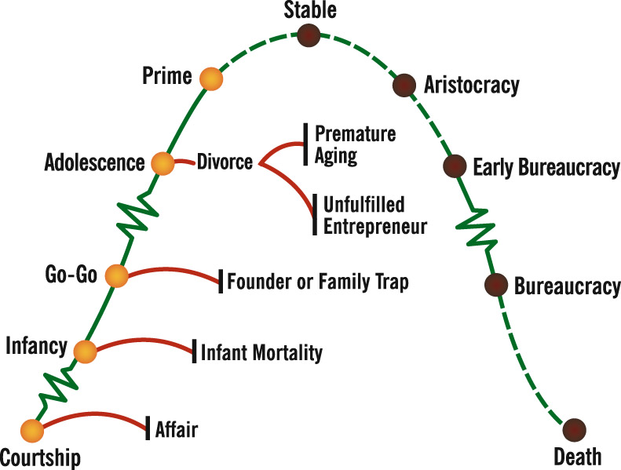
Lifecycle of an Organization – How does
Product Lifecycle Mirror this

Slide 30
Successful management is needed
For every business model
Opportunities
Capabilities
External Integration
f
SUCCESS
Internal Disintegration
Mutual Trust
Mutual Respect

Slide 31
Mutual Trust and Respect
People
Notes:
3131

Slide 32
Characteristics of a good manager
Is Well Rounded (Flexible in Style)
Knows Himself / Herself
Has Balanced View of Self
Accepts Self
Is Aware of Effect on Others
Can Identify Excellence in Others
Respects the Strengths of Others
Can Harness Conflict
Creates a Learning Environment
=
Mature, Well-Balanced Individual

Slide 33
Mutual Trust and Respect
Process
People
Notes:
3333

Slide 34
8 Steps in Decision Making
Defreeze
Accumulate
Deliberate
Incubate
Illuminate
Accommodate
Finalize
Reinforce
Short Decision Making
Long Decision Making
Long Imp.
Short Imp.

Slide 35
Types of Decision Making
Problem
Identification
Task
Identification
Criteria
Selection
Solution
Finding
Implementation
Planning
Reinforcment
Defreeze
Accumulate
Deliberate
Incubate
Illuminate
Accommodate
Finalize
Reinforce

Slide 36
Thank You!
Next week article
http://www.fastcompany.com/41088/i-can-only-compete-through-my-crew

